Slide 1
Project Report
Done by :
1- Ali Ahmed Hamed Shaker 20201701725
2- Mina George Raouf Iskander 20201701741
3-Ali Rafeeq Amer 20201701705
4-Diaaelden Amr 20201701720

Slide 2
Preprocessing

Slide 3
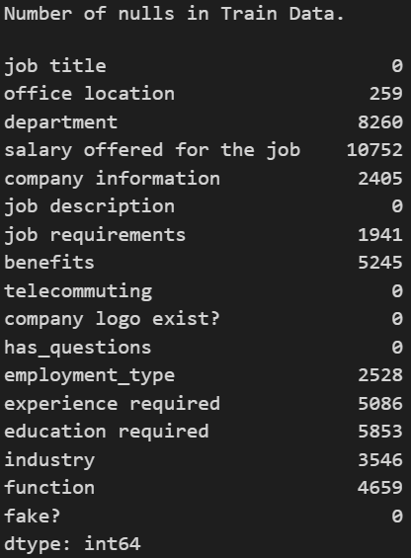
pre-processing techniques
1- Dropping some columns
Drop salary offered for the job column in train data because it has 84 % approx null values.
Drop salary offered for the job column in test data because it has 84 % approx null values.
Also we dropped telecommuting, has_questions, company logo exist? columns because they does not have any logical meaning.

Slide 4
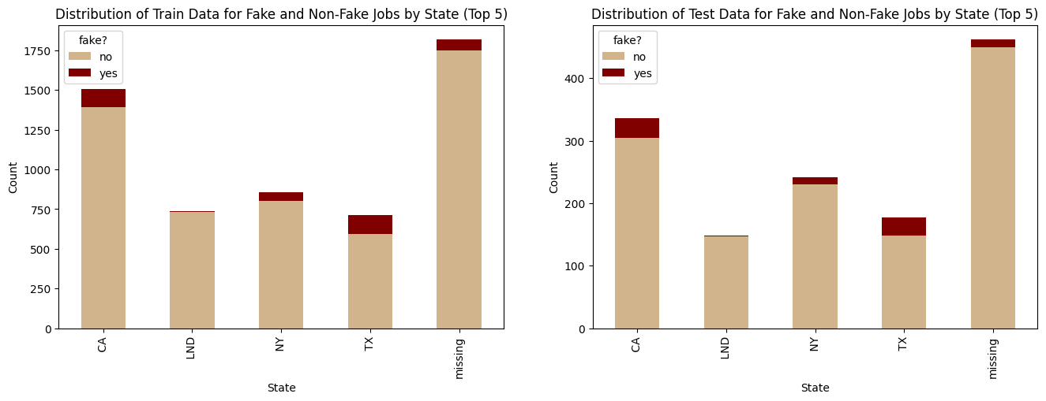
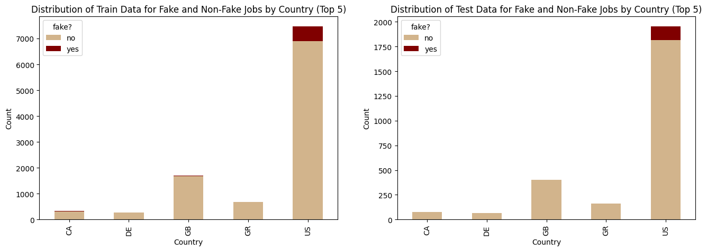
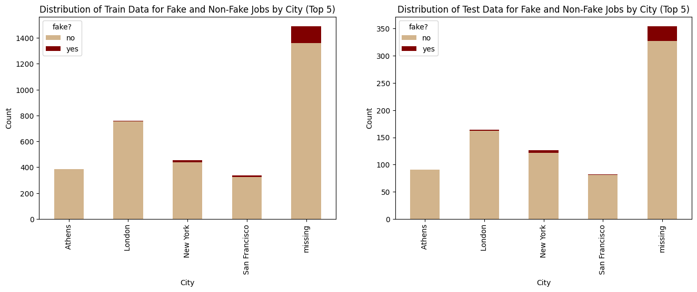
2- Splitting Column
# Split office location to country, state and city

Slide 5

3- Replacing null values
- Replace null values with key term “missing” in all columns
Merging text data into one column & deleting Nulls of ignored empty text
('company information', 'job description', 'job requirements', 'benefits’)
4- Encoding

Slide 6
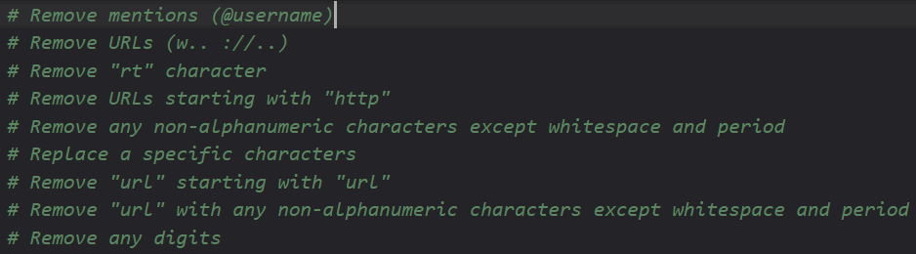
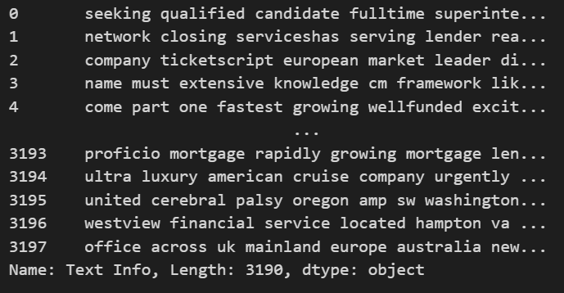
5- Text cleaning
# Removing special characters and tags using regular expressions
EX:
# Remove stop words : Stop words are commonly used words in a language that are removed from text data during natural language processing as they do not add much meaning to the overall context of the text.
# Lemmatize : Lemmatization is the process of reducing words to their base or dictionary form, which helps in reducing the complexity of text data and improving text analysis.

Slide 7
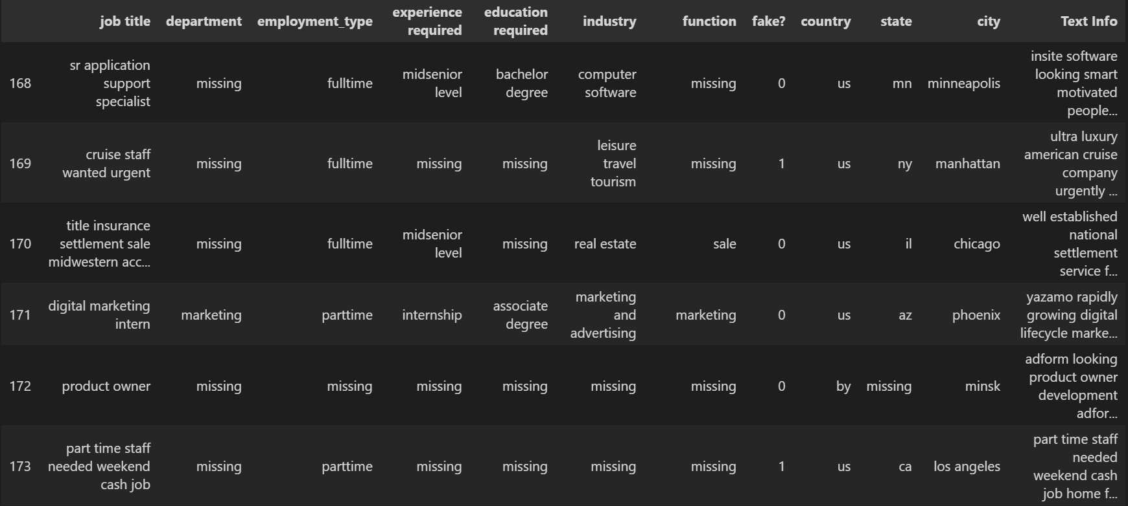

Slide 8

World Cloud

Slide 9
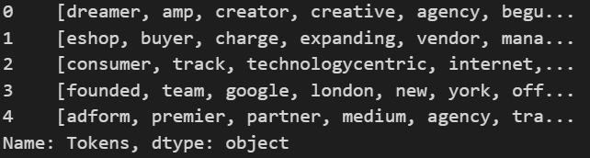
Feature Extraction
1-Tokenization: Tokenization is the process of splitting text data into individual units called tokens, which can be words, phrases, or other meaningful elements for natural language processing.

Slide 10
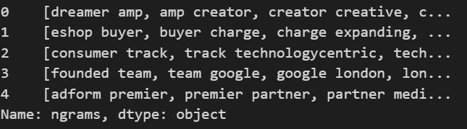
Feature Extraction
2- ngrams: N-grams are contiguous sequences of n items (usually words) from a given text, used in natural language processing and text analysis to analyze the frequency and co-occurrence of specific phrases or patterns.

Slide 11
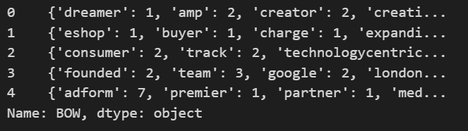
Feature Extraction
3- Bag of words : The bag-of-words model is a natural language processing technique that represents text data as a bag (multiset) of its words, disregarding grammar and word order but keeping track of the frequency of each word.

Slide 12
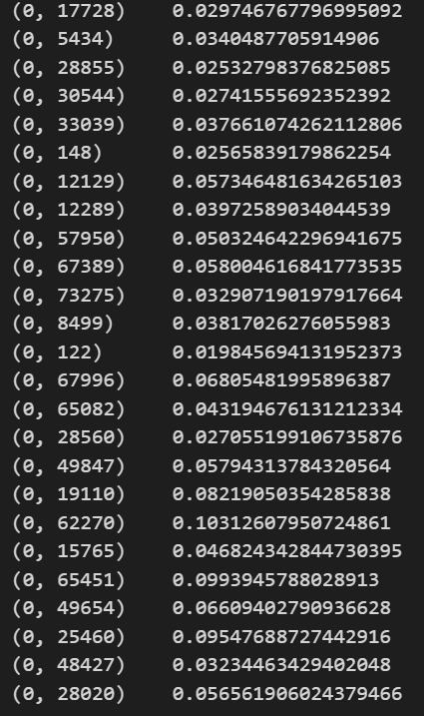
Feature Extraction
4- TF-IDF: TF-IDF (term frequency-inverse document frequency) is a statistical technique used to evaluate the importance of each word in a document, relative to its occurrence in a corpus of documents.

Slide 13
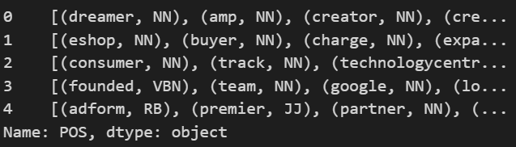
Feature Extraction
5- part of speech: Part of speech refers to the grammatical category that a word belongs to, based on its function and relationship to other words in a sentence, such as nouns, verbs, adjectives, adverbs, prepositions, and conjunctions.

Slide 14
Models

Slide 15
Models
1-Logistic Regression: a simple and efficient linear model that is widely used for binary classification tasks and can be extended to multiclass problems.
2-Random Forest: an ensemble learning method that combines multiple decision trees to improve the accuracy and robustness of the model for both binary and multiclass classification tasks.
3-CNN (Convolutional Neural Network): a deep learning model that uses convolutional layers to extract features from images or other multidimensional data and learn patterns for classification or regression tasks, and is especially effective for image classification.
4-SVM (Support Vector Machine): a versatile and powerful model that finds a hyperplane to separate data into different classes by maximizing the margin between them, and can be used for both binary and multiclass classification tasks.

Slide 16
Hyperparameters
n : (n = 2 # best parameter for n-grams(,the hyperparameter n is set to 2, which means that the model will consider pairs of adjacent words (bigrams) when creating n-grams. This is a common choice for text classification tasks, as bigrams can capture some of the contextual information and the relationship between adjacent words that unigrams (single words) may miss.
Batch size : When comparing two CNN models with different hyperparameters, specifically batch size and filter size, it was observed that a model with a larger batch size of 100 and filter size of 64 achieved a lower training time compared to a model with a smaller batch size of 60 and filter size of 32. Furthermore, the model with the larger batch size also achieved higher accuracy results.
n_estimator: It has been observed that setting the 'n_estimators' hyperparameter to 100 in a Random Forest model resulted in higher accuracy compared to other values of this hyperparameter, specifically n_estimators=60 and n_estimators=150.
Number of epochs: After experimenting with different values of the 'epochs' hyperparameter in a CNN model, specifically with values of 15 and 12 epochs, it was observed that the accuracy remained unchanged after exceeding 10 epochs.

Slide 17
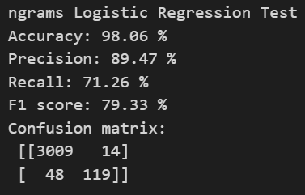
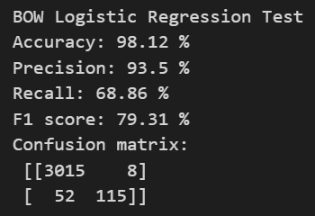
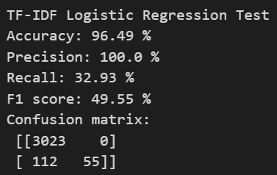
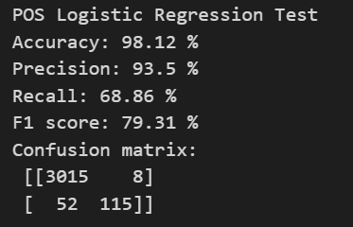
Logistic Regression

Slide 18
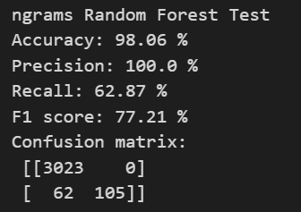
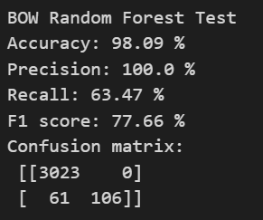
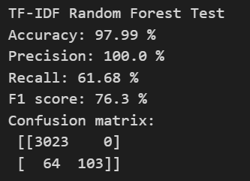
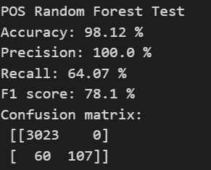
Random Forest

Slide 19
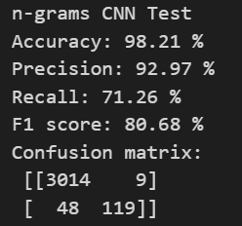
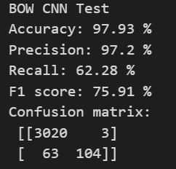
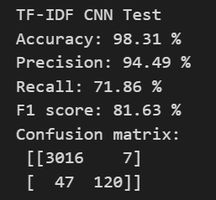
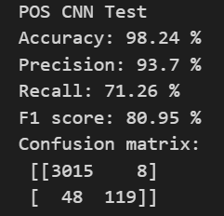
CNN

Slide 20
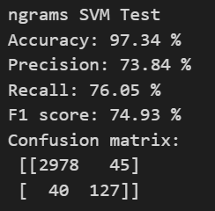
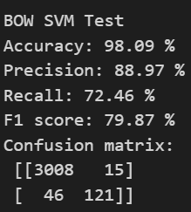
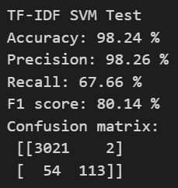
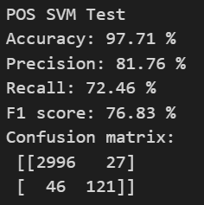
SVM

Slide 21
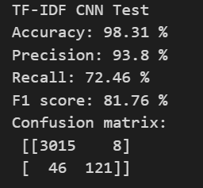
Models Evaluation
Best Model is " CNN " with combination with " TF-IDF "

Slide 22

Thank you

